Slide 1
SANS Webcast
Simplifying Response with the MITRE ATT&CK Framework
Justin Henderson (GSE # 108) and JJ Cranford
@SecurityMapper .

Slide 2



About Us
Justin Henderson
SEC555 Author / SEC455 and SEC530 Co-Author
GSE #108 / Cyber Guardian Blue + Red / 61 certs
Owner of H & A Security Solutions
Twitter: @SecurityMapper
Anthony Di Bello
VP Strategic Development - OpenText
Responsible for infosec, legal, & AI/ML solutions
15 years with EnCase
JJ Cranford
Senior Product Marketing Manager
Responsible for go-to market for EnCase

Slide 3
Detection, Prevention, and Response
Organizations place focus on detection and prevention
Often, response does not receive enough attention
Traditional Alert
“Computer HR01 is infected by the remote access trojan (RAT) FlawedAmmyy”
Now what?

Slide 4

Response Challenges
Multiple challenges when taking actions during response
Without context response is slow and uninformed
Haste is important but moving too fast is problematic
Incorrect actions taken directly impact business
Containment and remediation requires careful sequencing
Attacks may span multiple assets

Slide 5
Simplifying Response
Response without context suffers all the prior challenges
It is widely inefficient, tiring, and painful
The trick is to turn response into an informed decision tree
Given that X has been found look for related events
Identify known behaviors and actors
Correlate information into a storyline
Then YOU decide how the story should end
How about automation of the above?

Slide 6
Modern Attacks
Trick to simplify response is to automate knowledge of modern attacks
Requires understanding complexity
Attack can be zero-day or live off the land
Can involve multiple steps
Requires knowing where to look
Processes, network connections, DLLs, registry, files, etc.
On disk or in memory

Slide 7
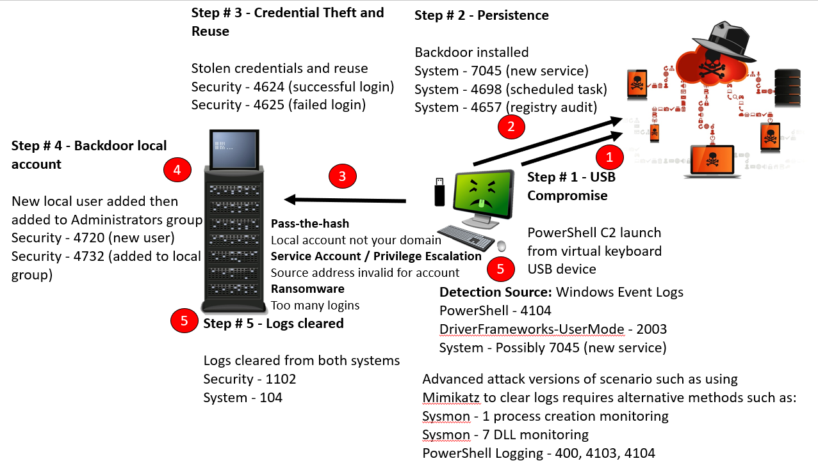
Modern Attack – Basic Example

Slide 8

MITRE ATT&CK Framework
Automation is possible by utilizing the MITRE ATT&CK Framework
Adversarial Tactics, Techniques, and Common Knowledge
Repository of well documented behaviors useful for detection, prevention, and response capabilities
More than just theoretical knowledge

Slide 9
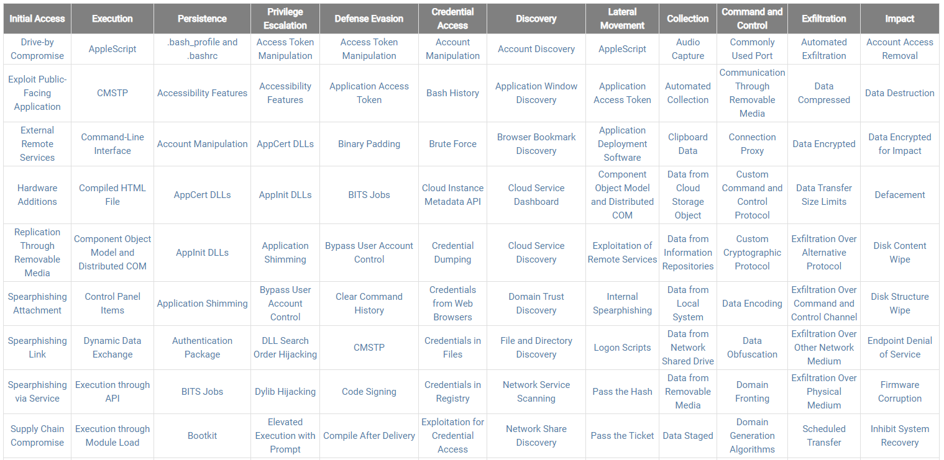
MITRE ATT&CK Matrix

Slide 10
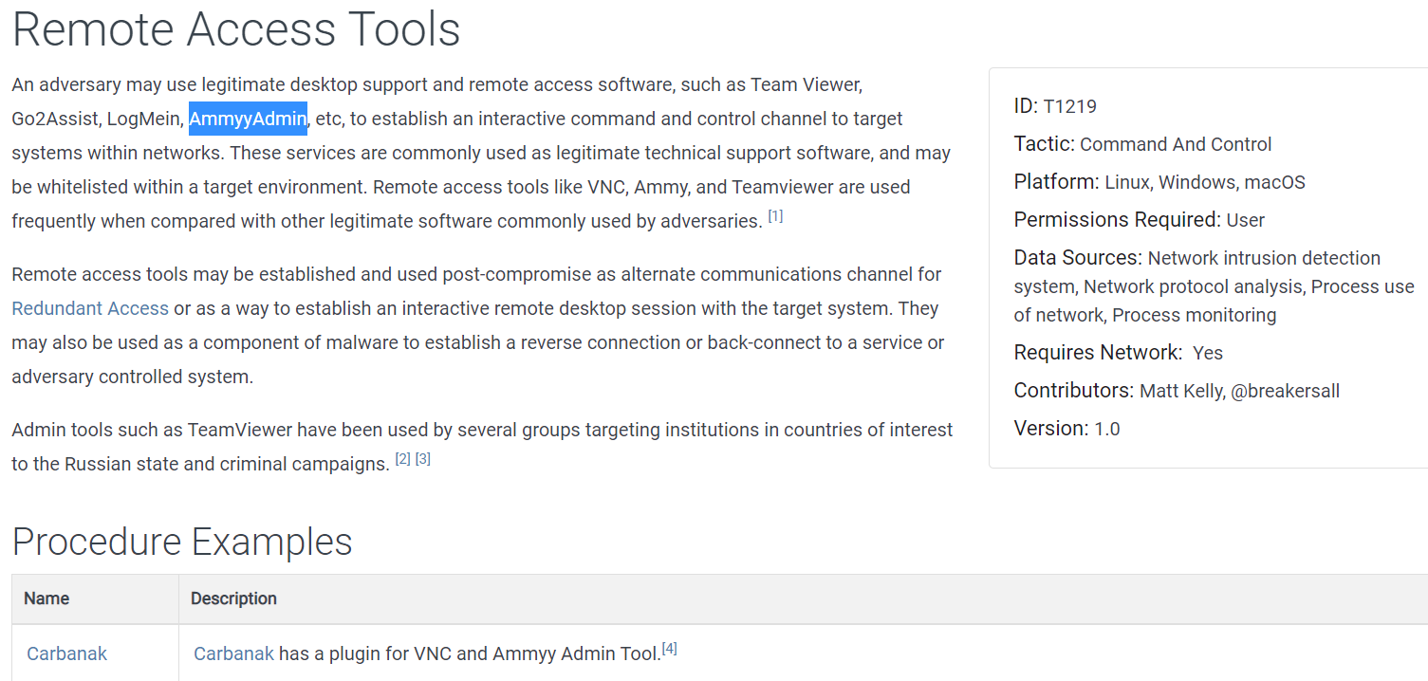
Drill Down within Matrix – Remote Access Tools

Slide 11
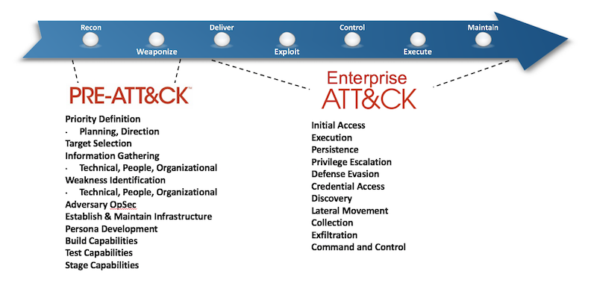
MITRE and Cyber Kill Chain®

Slide 12

Different Approach to Response
“Computer HR01 is infected by the remote access trojan (RAT) FlawedAmmyy” – T1219
Before human consumption automate these steps:
What user and process are associated with T1219 activity
Check endpoint for related events
When and what process downloaded the RAT
Did it spawn additional processes
Did it access any files
Where other internal systems involved

Slide 13
Building a Storyline
Using MITRE ATT&CK, it is possible to automate the initial story
8:20 AM User receives email with Excel attachment - T1193
8:37 AM Excel document opens with macros enabled – T1204, T1064
8:38 AM msiexec downloads initial payload which is an MSI installer that extracts and runs RAT directly in memory - T1218
8:38 AM Persistence established via registry – T1060
Initial alert catches T1218. MITRE response associates T1218 to T1193, T1204, T1064, and T1060 into a written story
Notes:
For a detailed outline of one example of FlawedAmmy’s use cases see the link below: https://security-soup.net/flawedammyy-rat-excel-4-0-macros/

Slide 14

Time Savings
Prior slide involves at least five documented MITRE techniques
Traditionally these would require manual investigation
Assuming a trained staff member this might take 30 minutes to multiple hours to identify
An untrained staff member would likely miss any or all these techniques

Slide 15

Context Driven Remediation
MITRE ATT&CK brings contextual alerts rather than single point in time alerts
The result is less time investigating and an ability to make informed decisions during remediation
Given scenario you might:
Contain system and then reimage
Remove persistence and malware as well as cleanup Excel file (no reimage)
Or [insert decision here]

Slide 16
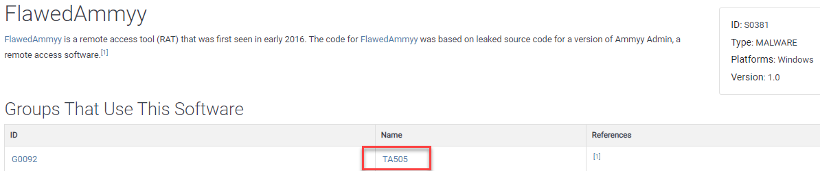
Threat Groups
Combination of techniques may identify a threat group
MITRE maintains list of known threat groups
Knowledge aids in knowing what may come next
Or other techniques to look for that may not have been automatically detected

Slide 17
Which Would You Rather
Traditional Context
MITRE-driven Context
Often limited to single point
Manual correlation if any
Higher chance of false positives
Slow process
Uninformed decision making
Multiple, documented points
Automatic or manual correlation
Low chance of false positives
Ability to use MITRE to eliminate false trails/alerts
Fast process
Informed decision making

Slide 18
Automating MITRE-driven Context
MITRE ATT&CK is a framework
Does nothing by itself
Put another way “needs applied”
Multiple methods to incorporate MITRE
Endpoint Detection and Response (EDR)
Security Information and Event Management (SIEM)
Security Orchestration Automation and Response (SOAR)
Automation native in some commercial platforms
Non-commercial solutions require lots of scripting and labor

Slide 19
Applying ATT&CK at scale with EDR
Notes:
Endpoint Security Sales Campaign

Slide 20










MITRE ATT&CK
Coherent Results
With EnCase™
Endpoint Security
Clear and actionable next steps paired with supporting threat information
Cybersecurity Threats
Historically complex, require years of security expertise to investigate and remediate
MITRE ATT&CK
Match threats with available defenses by demystifying attacker TTPs

Slide 21






EDR has been a challenge
On-Prem Devices
Lack of repeatable detection criteria
Extended time-to-value/lengthy deployments
Move to complex hybrid environments
Context has been lacking
Scale continues to be a problem
Black box approach to AI/ML less effective for the large enterprise – each enterprise really is a snowflake
Application
Azure App Proxy
Digital Workplace
Management
Intune
MS365
Internet
AWS
Shops
Private Cloud
Data Center
Warehouse
HQ
Azure

Slide 22
Current approaches are manual and noisy
Bloated Agents
Negative performance impact on endpoints
Network burden on deployment and upgrade
Excessive Scanning
Large number of false positives
A disproportionate number of jobs
Burdens software architecture – slower response
Noise & Overcollection
Unnecessary collections cause increased network traffic
Extra overhead for analysts and the network
Too much data to sort and prioritize

Slide 23
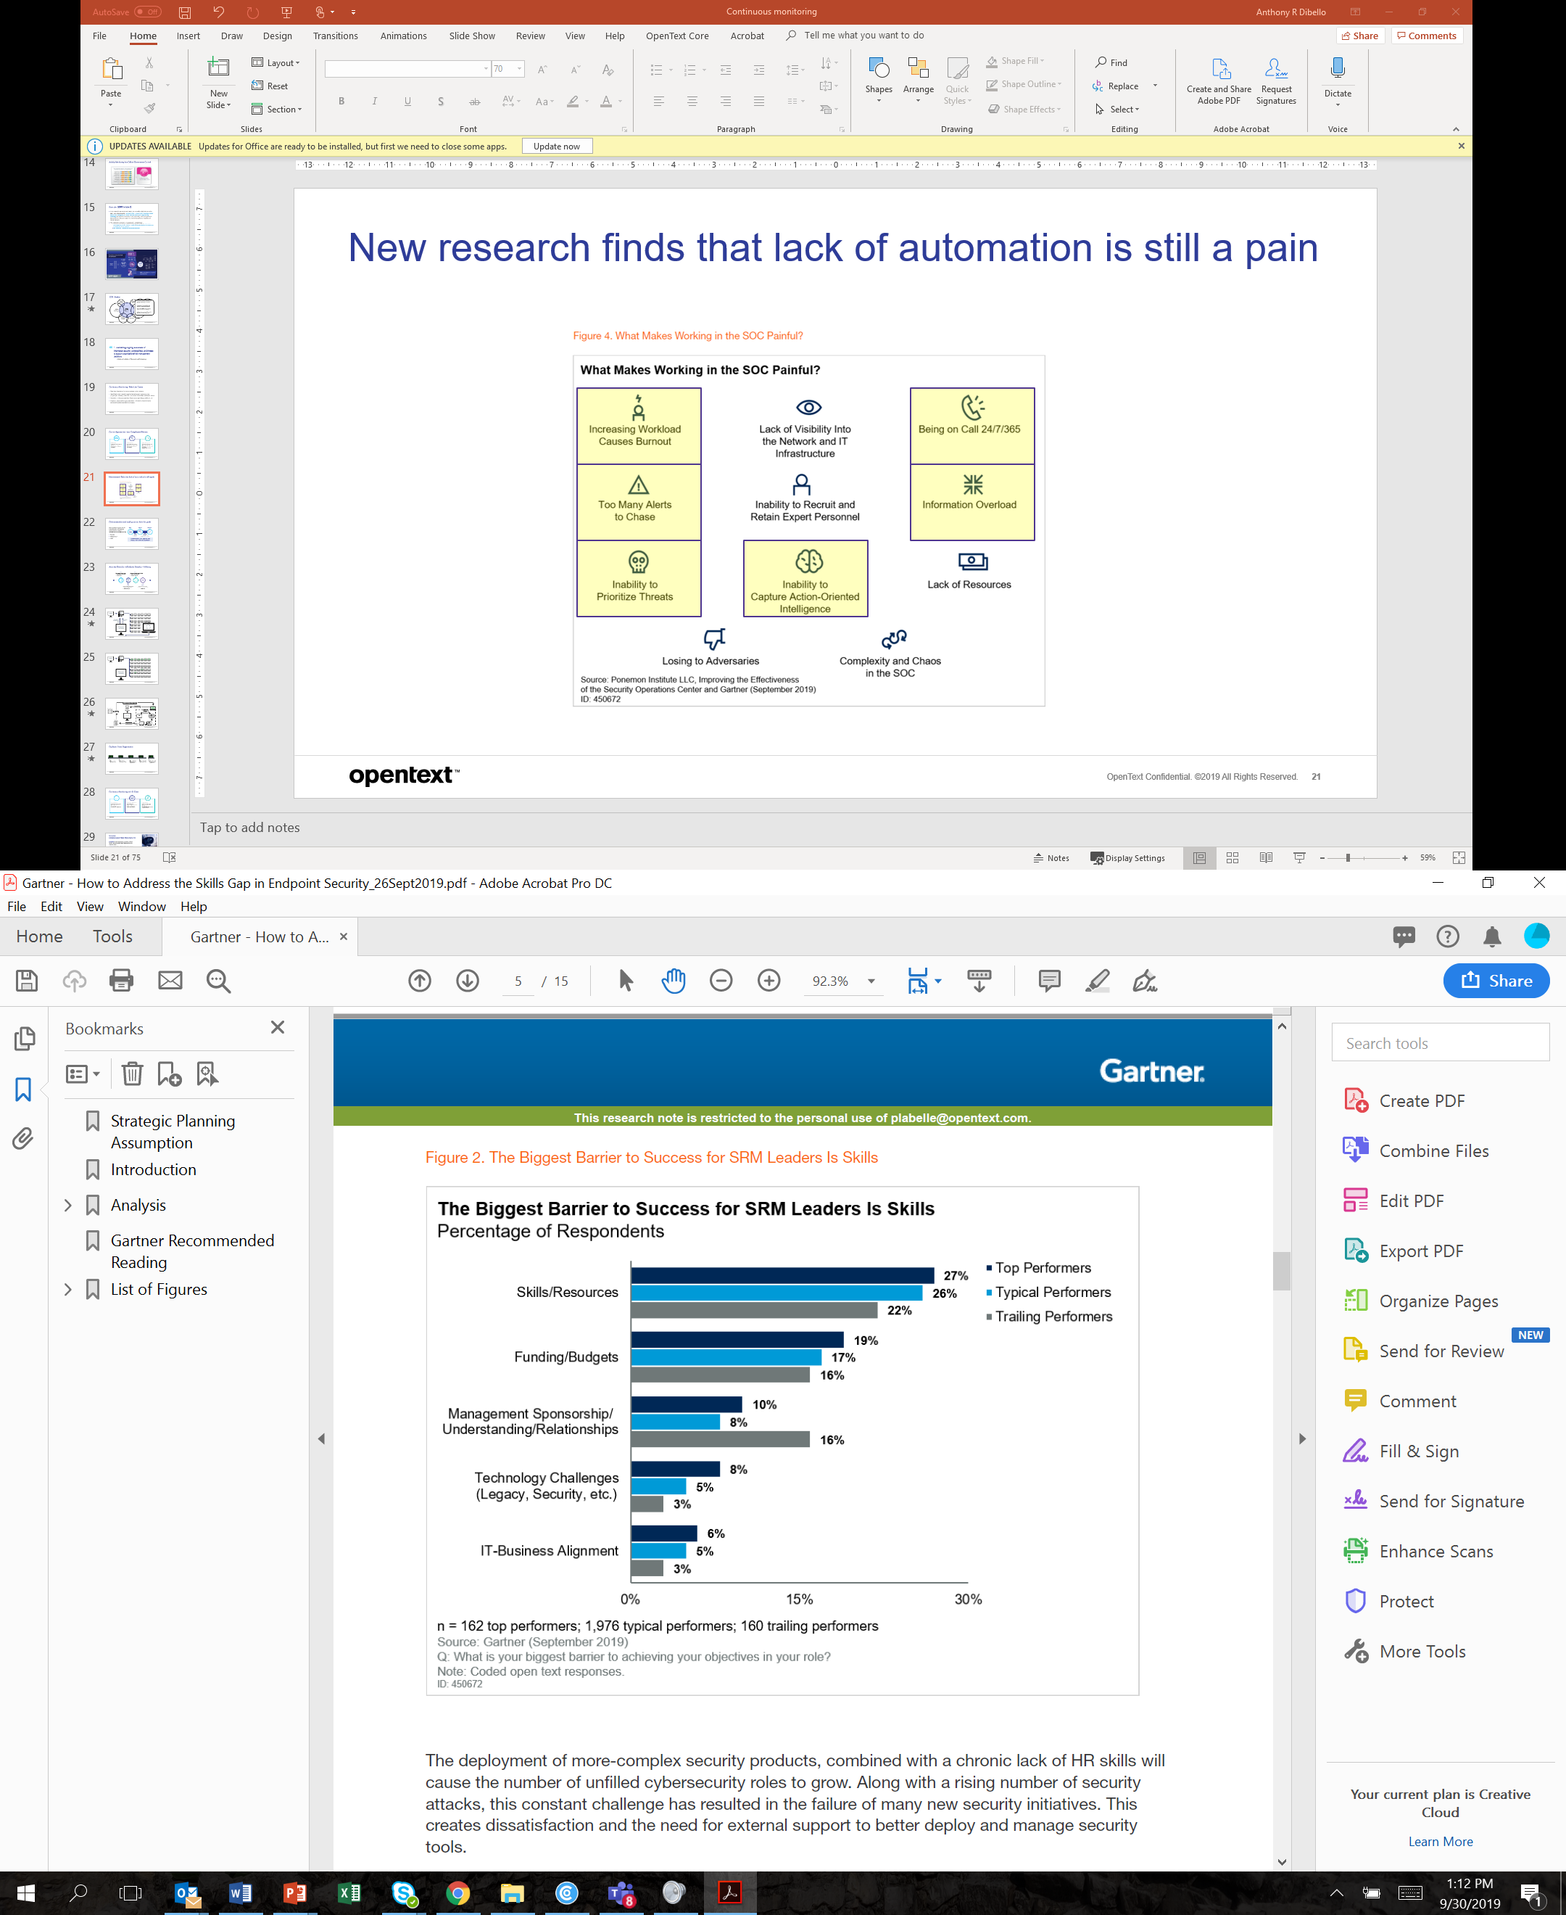
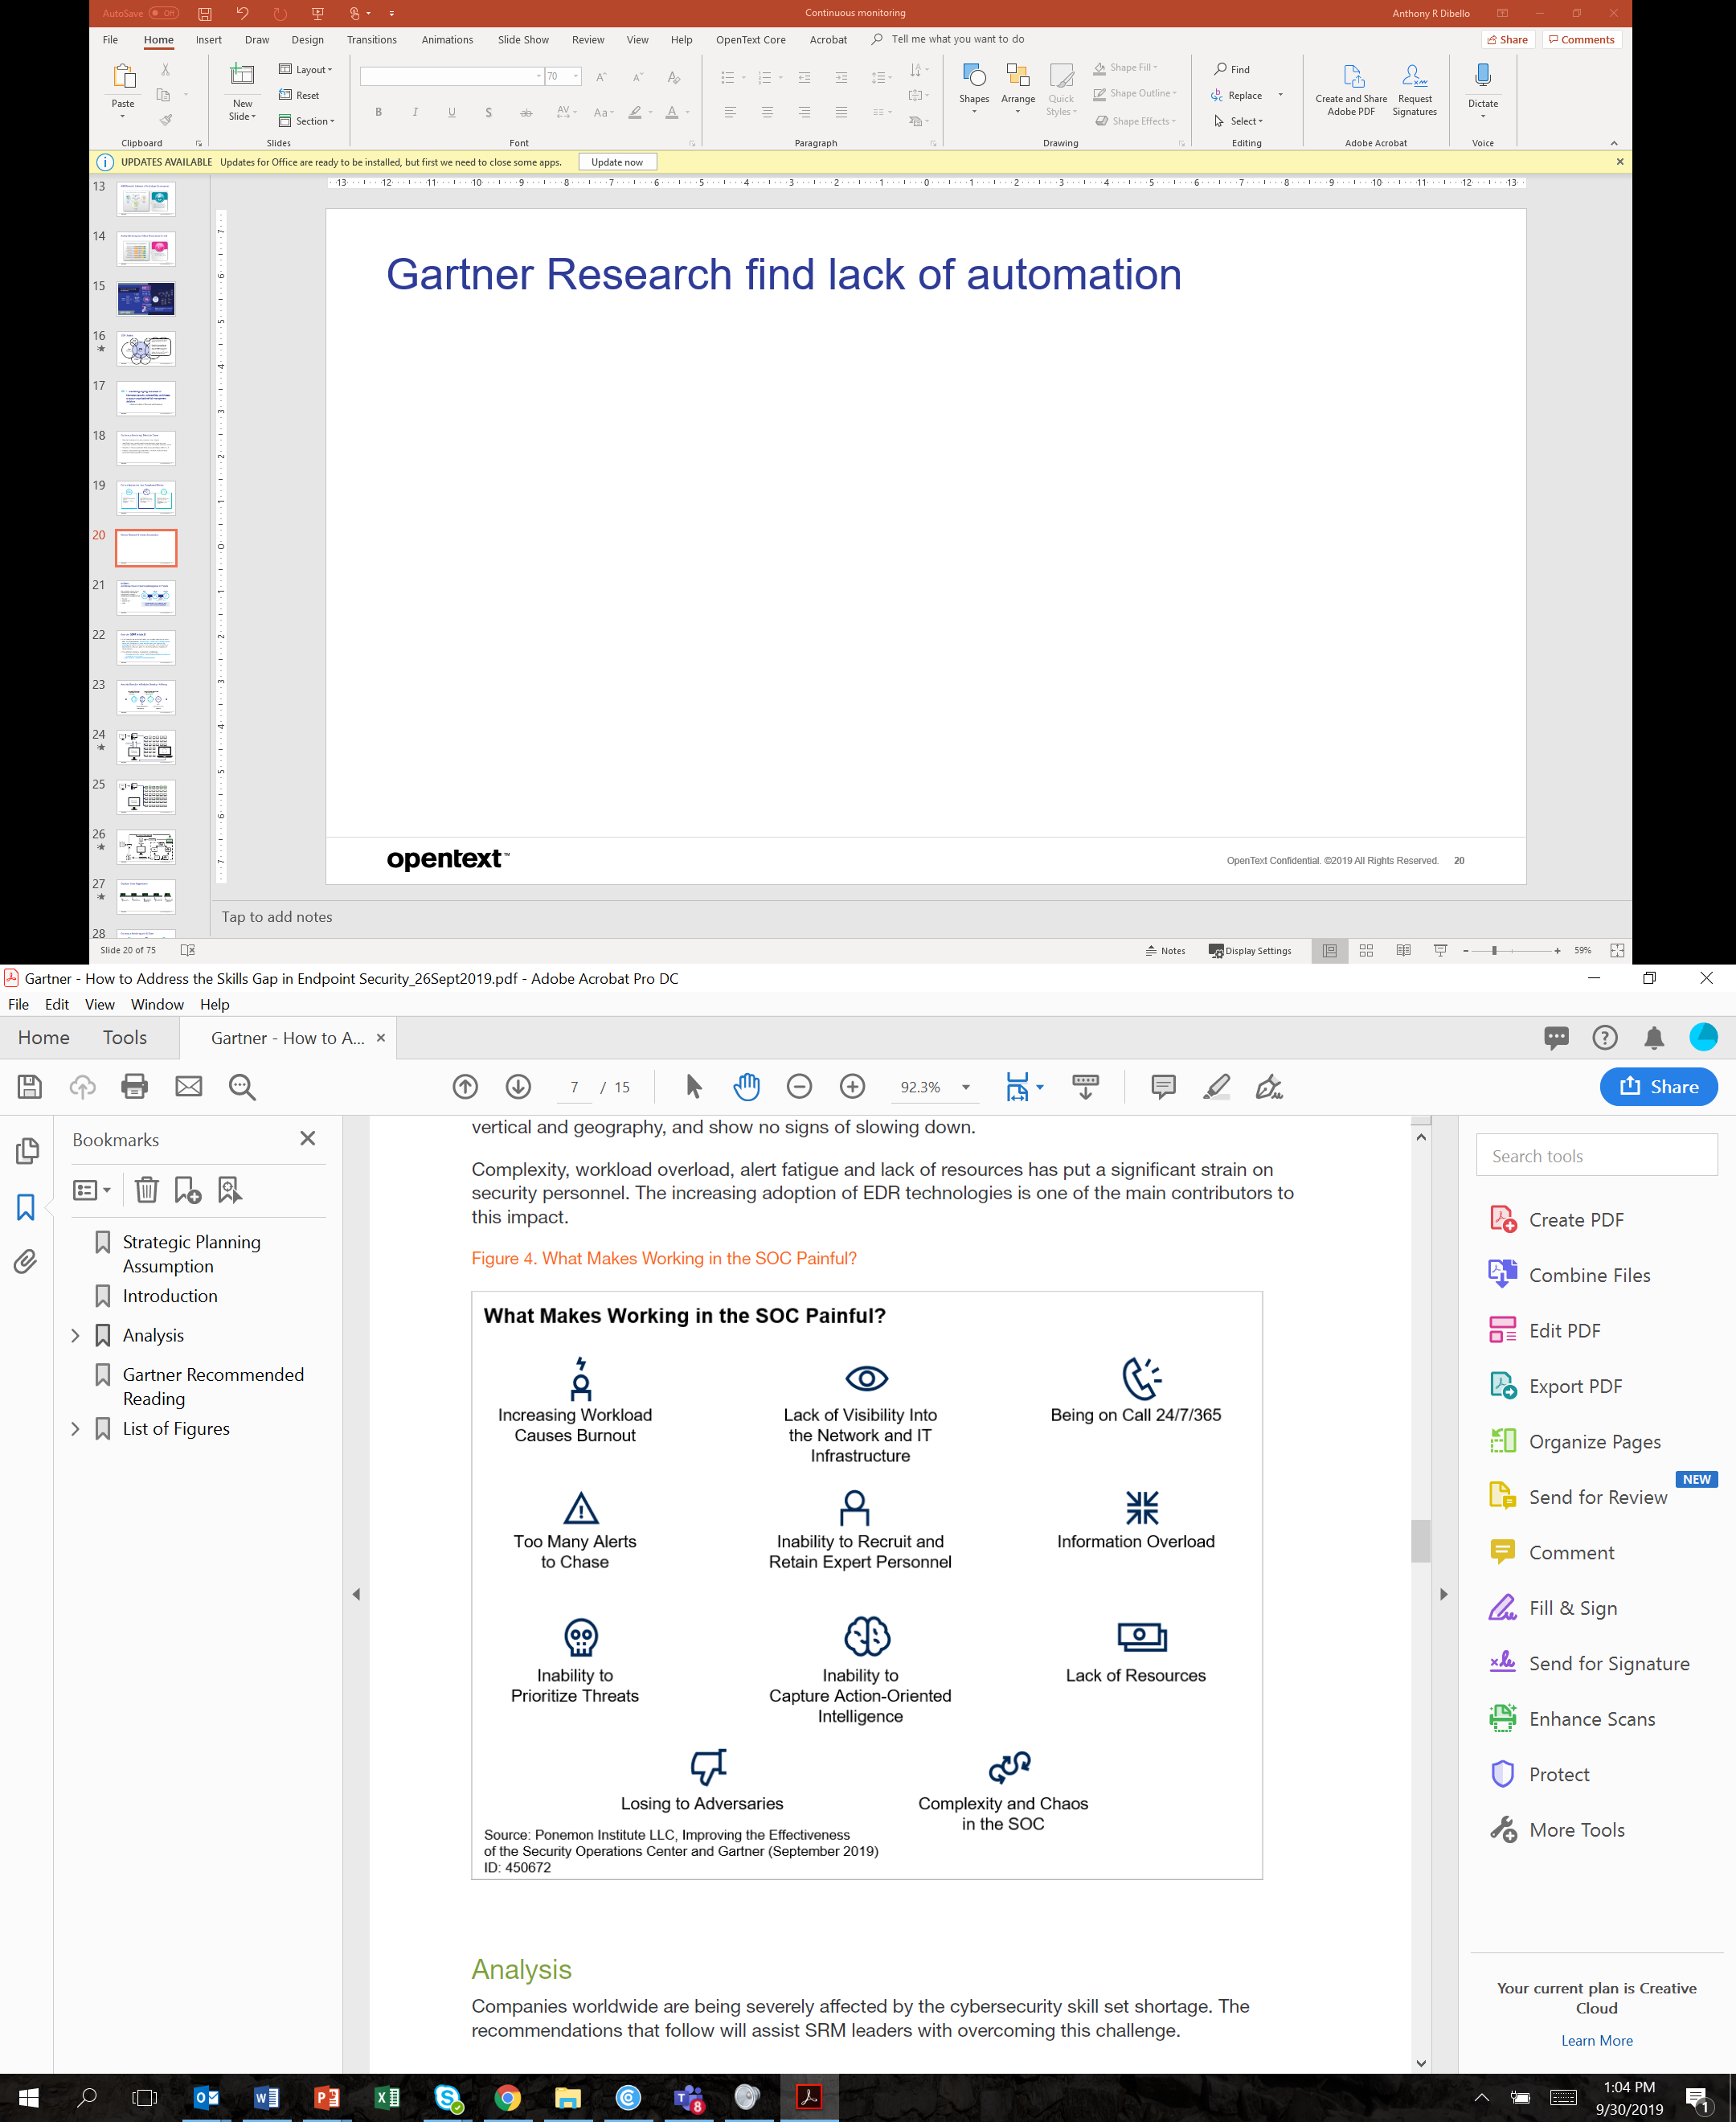
New research finds that lack of automation is still a pain

Slide 24
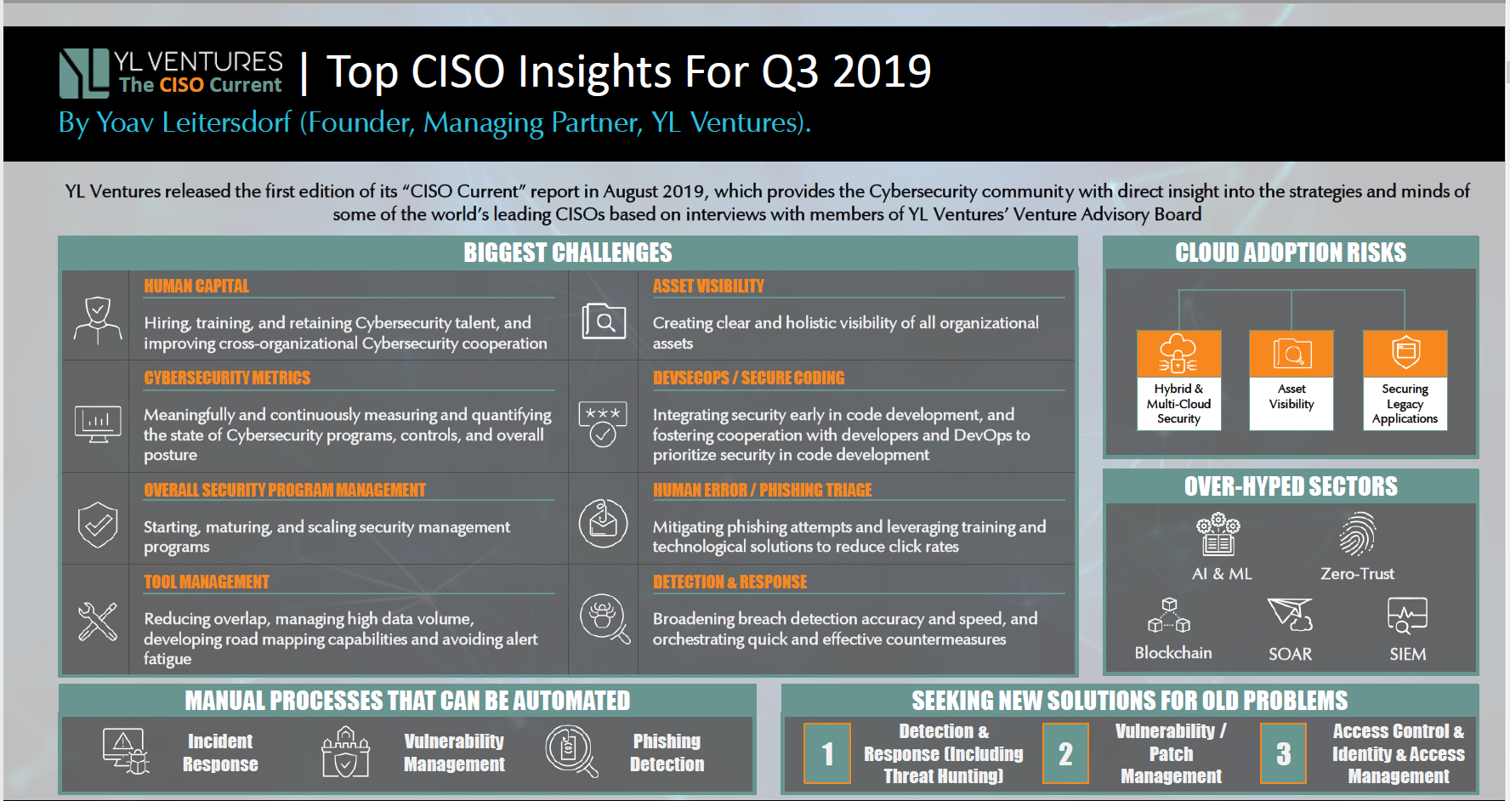

Slide 25
What’s Required?
Endpoint Visibility into Threats to Data at Scale
Real-time visibility and alerting across your entire network
Identification and initial response in less than 15 minutes
Detection of anomalies and threats on endpoints on or off the network including cloud
Easy to Setup, Run, and Maintain
Compatibility with other agents and products
One time set up lets the user set it and forget it
Out-of-the-box (MITRE) & easy rule creation and sharing/re-use
Resource Management and Scalability
Relatively small footprint on the endpoint
Collect data only when needed
Ability to manage multiple scan frequencies and types across definable network segments
Notes:
Overall system scalability – Instead of the EA pushing us the database, we go and collect. This prevents the system from getting overloaded by vague/general rules.

Slide 26
Not all Endpoints are Created Equal
Endpoint Profile
Location
Function
Type
Connectivity
Data Profile
Sensitive/regulated information
Applications
Threat Profile

Slide 27
Continuous Monitoring with EnCase Endpoint Security
Event Log
Sch.Tasks
Connections
Files
Registry
Threads
Drivers
Handles
DLLs
Processes
5 minutes
5 minutes
5 minutes
5 minutes
5 minutes
5 minutes
5 minutes
5 minutes
5 minutes
5 minutes
5 minutes
5 minutes
5 minutes
5 minutes

Slide 28
Continuous Monitoring with EnCase Endpoint Security
5 minutes
5 minutes
5 minutes
5 minutes
5 minutes
5 minutes
5 minutes
5 minutes
5 minutes
5 minutes
5 minutes
5 minutes
5 minutes
5 minutes
Event Log
Sch.Tasks
Connections
Files
Registry
Threads
Continuous &
Uninterrupted
Drivers
Handles
DLLs
Processes

Slide 29
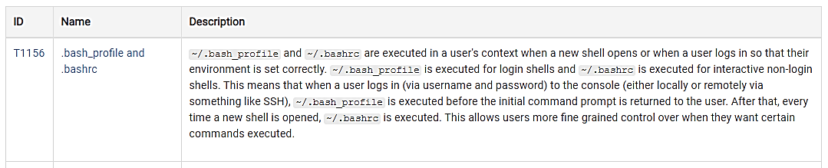
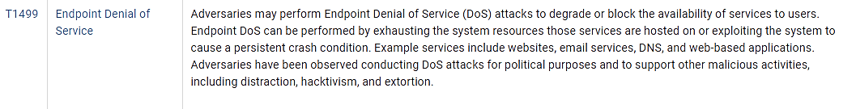
Attack Techniques – Enterprise
Organize and classify adversarial behaviors commonly seen in enterprise cyber attacks
Mitre results are separated by technique, and EnCase™ Endpoint Security matches that technique to a detection rule
MITRE ATT&CK is not academic or theoretical, it’s based on attack methods seen in live security environments. This framework describes real-world techniques in a clear way to orchestrate detection. Designed to work in the real world, against real threats.
Enterprise ATT&CK
Initial Access
Execution
Persistence
Privilege Escalation
Defense Evasion
Credential Access
Discovery
Lateral Movement
Collection
Command and Control
Exfiltration
Impact

Slide 30
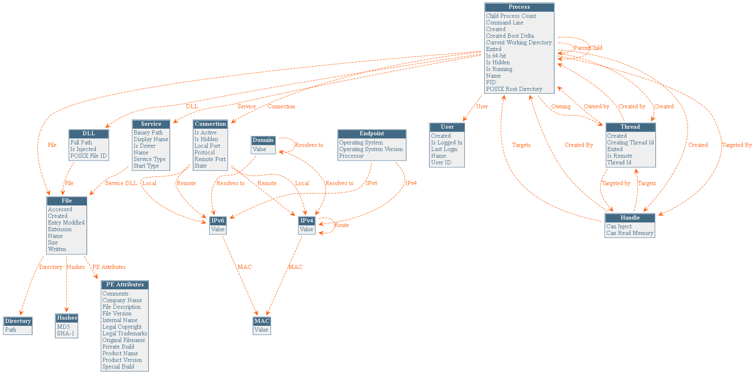
Anomaly Rule Schema
BACK

Slide 31
Runs Download Job & Deploys Updated Rules
Download Results
Examiner Service
Report Database
Anomaly Rules Deployed to the Endpoint
Take a Snapshot of the Endpoint
Run that Snapshot against Rules
Anomaly Detected
Sleep
Worker
Examiner (User Interface)
Task Queue
Request Pickup
Notes:
Architecture view of continuous monitoring
Horizontally scalable, goes through threat intel before coming to the analyst
Analysts don’t have to sort through white noise, alerts are brought to them in real time as the anomaly occurs. Different than telemetry
Hindering endpoint performance with resource heavy agents
Overburdening the network with excessive data
Inundating analysts with too much (irrelevant) information
Monitoring endpoints off the network
Enterprise level scalability
On average, it took companies 197 days to identify a data beach and 69 days to contain it. – IBM study
-Enhanced agent
-Online/offline collection
-Constantly looking for anomalies – aka broken rules/policies (powershell out of Excel – create an event)
-Lots happens on the backend of the event creation – a request is sent for the data, the data is downloaded and run through TI, and comes back scored and categorized for the security analyst

Slide 32
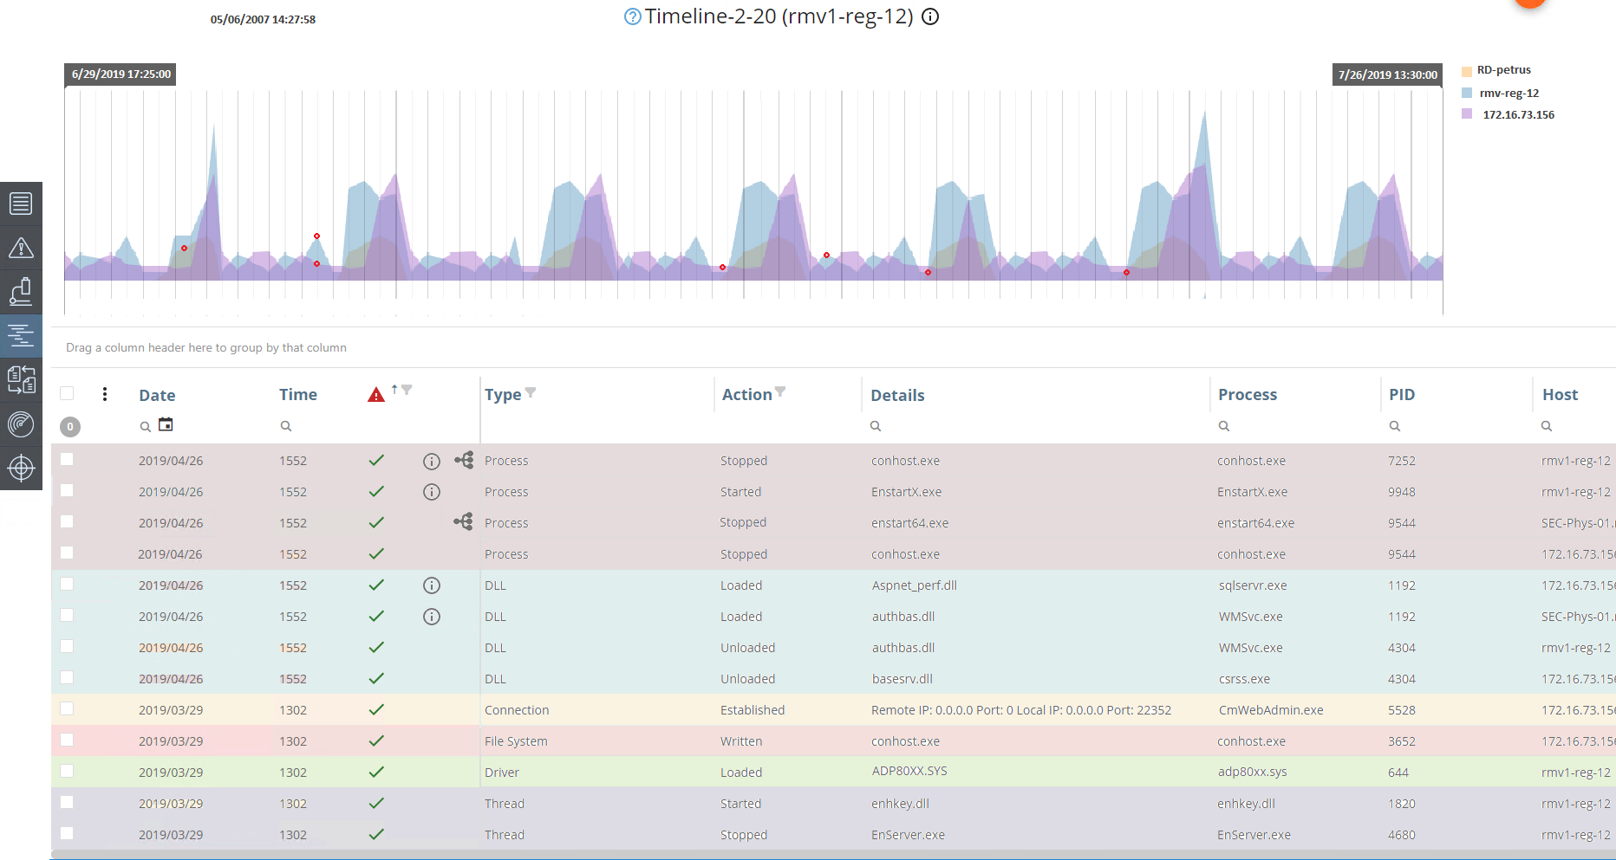
Bringing it Together: Unified Timeline

Slide 33

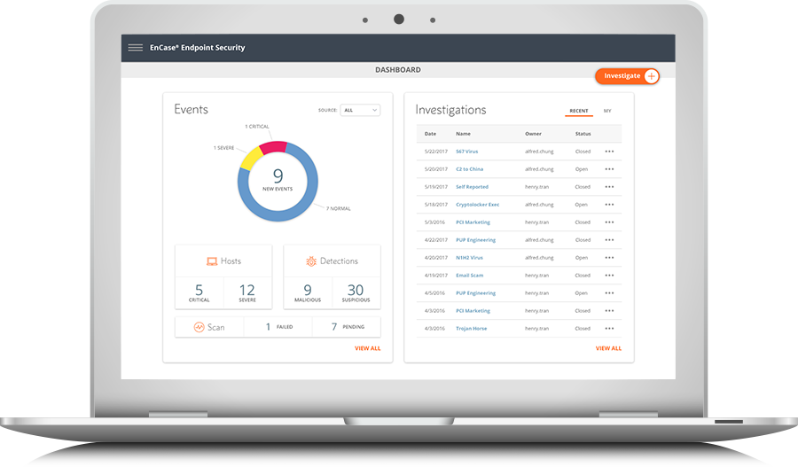
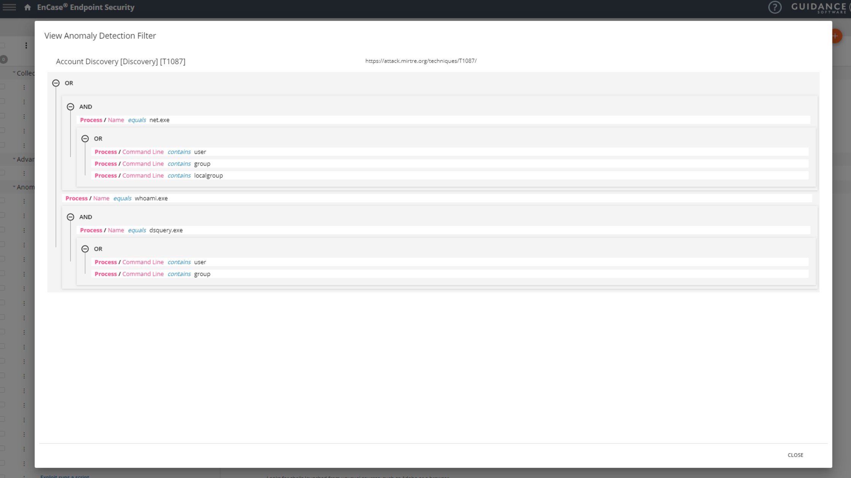
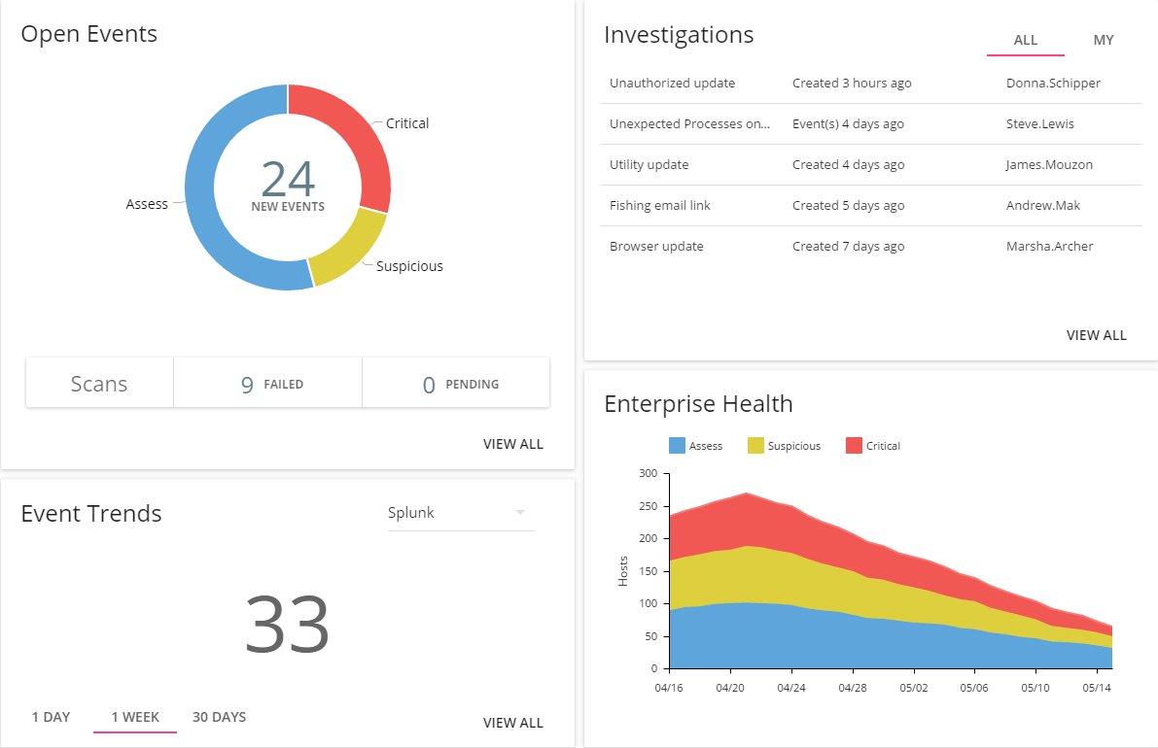
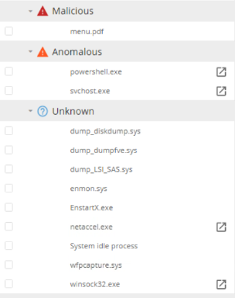
Advanced Threat Detection
Real-time monitoring and behavioral anomaly detection against:
Processes
DLLs
Handles
Drivers
Threads
+auto-recurring forensic-grade queries (snapshots) of all other potentially relevant threat artifacts
Targeted detection with rules and Mitre ATT&CK
400+ new anomaly detection values
OOTB rules based on SANS Know Evil framework
45+ MITRE-inspired anomaly detection rules available OOTB
Lower barrier for entry for junior security analysts
Ability to create custom anomaly rules is a force multiplier for Tier III experts and power-users

Slide 34
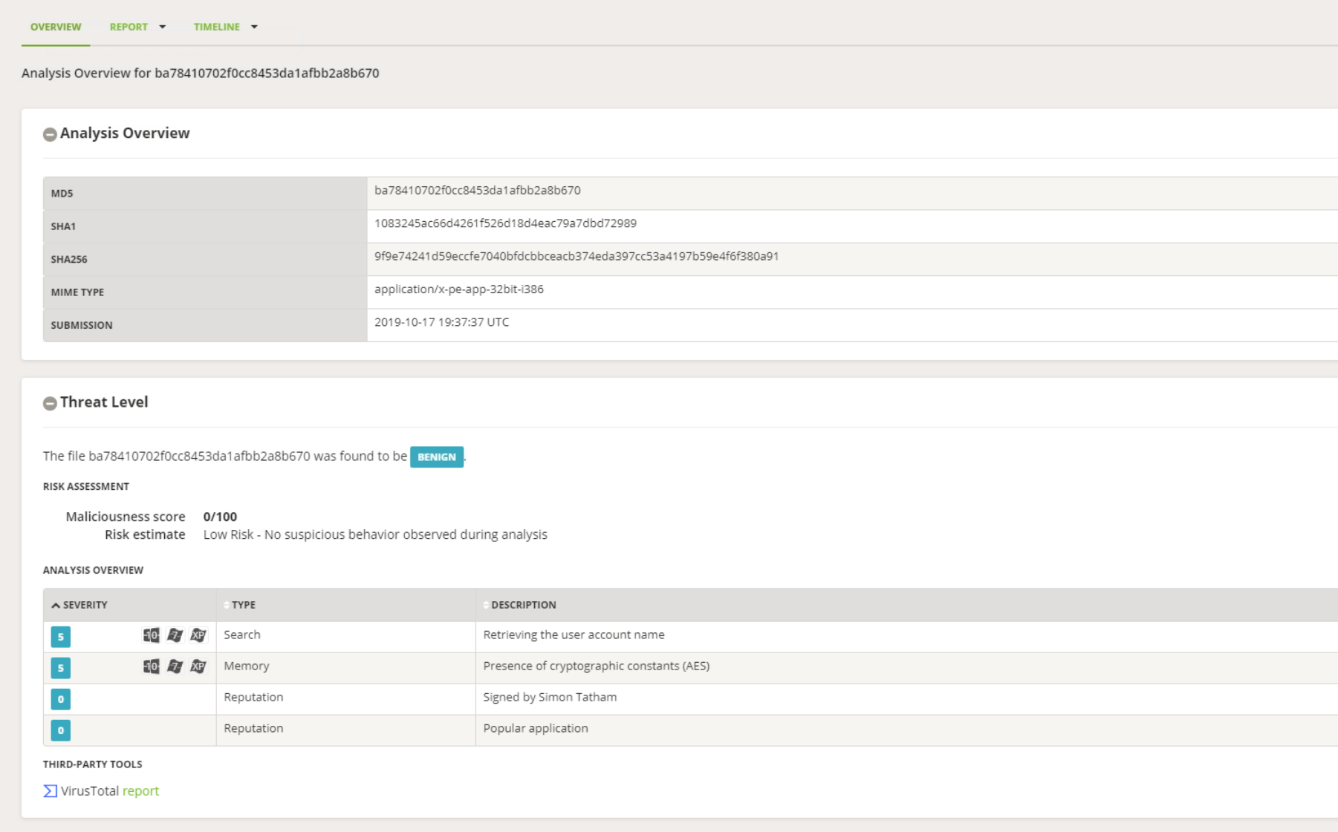
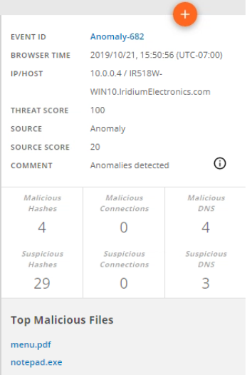
Threat Intelligence & Alert Contextualization
Embedded Threat Intelligence
Threat scoring for event triage
IP reputation that identifies additional new threat categories
Connection origins – identify the geographic locations of connections to the enterprise
Anomaly rules and associated threat categories in the event details view
OpenText Dynamic Analysis
Dynamic analysis (sandboxing) of binaries to identify and contextualize zero-day threats
Extensible reporting on process behavior
Run processes against various operating systems

Slide 35
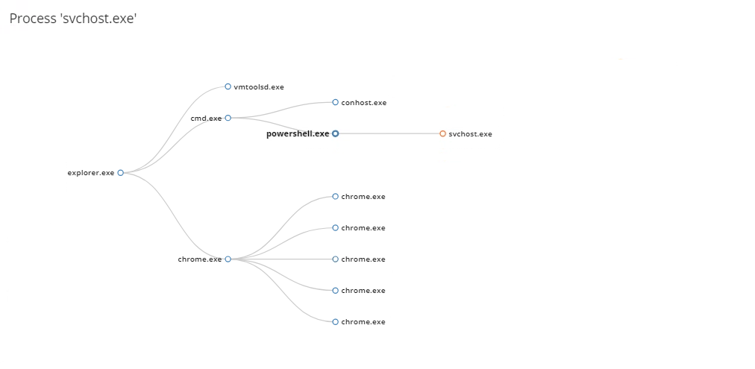
EnCase™ Endpoint Security
for endpoint detection and response
Advanced Threat Detection
Real-time, continuous monitoring
OOTB behavior-based anomaly rules
Anomaly rule builder for custom and targeted threat detection
Alert Contextualization and Triage
Threat scoring and intelligence on all inbound events from SIEM, IPS/IDS, and alerting tools
IP reputation analysis
Dynamic malware analysis for zero-day threat intelligence
Fearless Response
Simplified and comprehensive incident response
Full Tier III/DFIR feature-set for forensic-grade analysis
Notes:
For Product Unit level overviews

Slide 36
MITRE ATT&CK
Coherent Results
With EnCase™
Endpoint Security
Clear and actionable next steps paired with supporting threat information
Cybersecurity Threats
Historically complex, require years of security expertise to investigate and remediate
MITRE ATT&CK
Match threats with available defenses by demystifying attacker TTPs
www.opentext.com/security

Slide 37
Thank you!
Justin
www.opentext.com/security
Anthony
JJ

